Slide 1

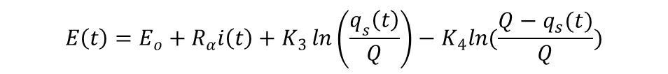

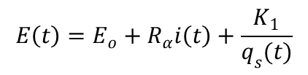
COMBINED BATTERY MODEL: MODEL DERIVATION
Shepherd/Unnewehr/Nernest Equations
The shepherd equation represents a simple approach for battery modeling
$E_{o}$ is the initial cell voltage
$R_{α}$ is the cell internal resistance
$q_{s}(t)$ is the instantaneous stored charge
$K_{1}$ is a constant.
Another further approximation is represented in the Unnewehr model
Another similar form is known as the Nernest Model as follows:
$$E\left(t\right)=E_{o}+R_{α}i\left(t\right)+\frac{K_{1}}{q_{s}(t)}$$
$$E\left(t\right)=E_{o}+R_{α}i\left(t\right)+K_{2}q_{s}(t)$$
$$E\left(t\right)=E_{o}+R_{α}i\left(t\right)+K_{3}\ln\left(\frac{q_{s}\left(t\right)}{Q}\right)−K_{4}ln(\frac{Q−q_{s}(t)}{Q})$$
Extended Kalman filtering for battery management systems of LiPB-based HEV battery packs Part 2. Gregory L. Plett

Slide 2
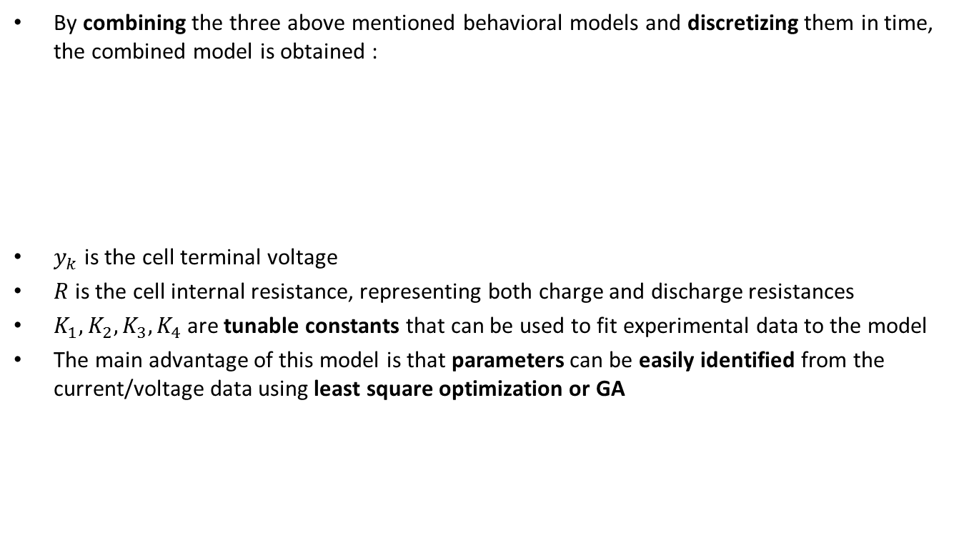

COMBINED BATTERY MODEL: MODEL DERIVATION
By combining the three above mentioned behavioral models and discretizing them in time, the combined model is obtained :
$y_{k}$ is the cell terminal voltage
$R$ is the cell internal resistance, representing both charge and discharge resistances
$K_{1}, K_{2}, K_{3}, K_{4}$are tunable constants that can be used to fit experimental data to the model
The main advantage of this model is that parameters can be easily identified from the current/voltage data using least square optimization or GA
$$y_{k}=K_{0}−Ri_{k}−\frac{K_{1}}{z_{k}}−K_{2}z_{k}+K_{3}\ln\left(z_{k}\right)+K_{4}\ln\left(1−z_{k}\right)$$
$$z_{k+1}=z_{k}−\left(\frac{η_{i}∆t}{C}\right)i_{k}$$
Extended Kalman filtering for battery management systems of LiPB-based HEV battery packs Part 2. Gregory L. Plett

